Slide 1
OCL-based Runtime Monitoring of JVM hosted Applications
OCL Workshop 2011
Lars Hamann, Martin Gogolla, Mirco Kuhlmann

Slide 2
Overview
Motivation
Related approaches
OCL-based Runtime Monitoring
  Overview
  Platform aligned model
  Snapshots
  Dynamic monitoring
Conclusion / Future Work

Slide 3
Motivation
MDD in an optimal way:
Current practice:
PIM
PSM₁
PSM_{n}
...
Defined model transformations
Executable program
PIM
PSM1
PSM_{n}
...
Defined model transformations
Handwritten code

Slide 4
Motivation
Possible other scenario:
  No executable code is produced “in house”
  PIM/PSM Models are used as the specification for components
  Implementation is “outsourced”
  Component is delivered as a black box
  Also: Assumptions about existing components

Slide 5
Motivation
Assumption:
Models are enriched with constraints, e. g., invariants, pre-/postconditions.
Question:
Does the resulting system satisfy them at runtime?

Slide 6
Related approaches
Weaving (mainly done with AOP)
Drawbacks:
  The implementation is modified:
    Weaving into the source code
    On the fly integration into VMs
  Is the runtime behaviour still the same?
  Difference between debug and release version when weaving into the source code
  Monitoring needs to begin at start up time

Slide 7
Related approaches
Unit Tests
Drawbacks:
  Only simulate execution of parts of the application
  The test writer needs deep knowledge about the system:
    Setup of the system core
    The right sequence of operation calls

Slide 8
OCL-based Runtime Monitoring
Benefits
  Source and byte code is untouched
  Monitoring can start at any time
  Monitored application can be paused and explored
Requirements:
  A platform aligned model
  Convenient runtime environment, e. g., the JVM

Slide 9
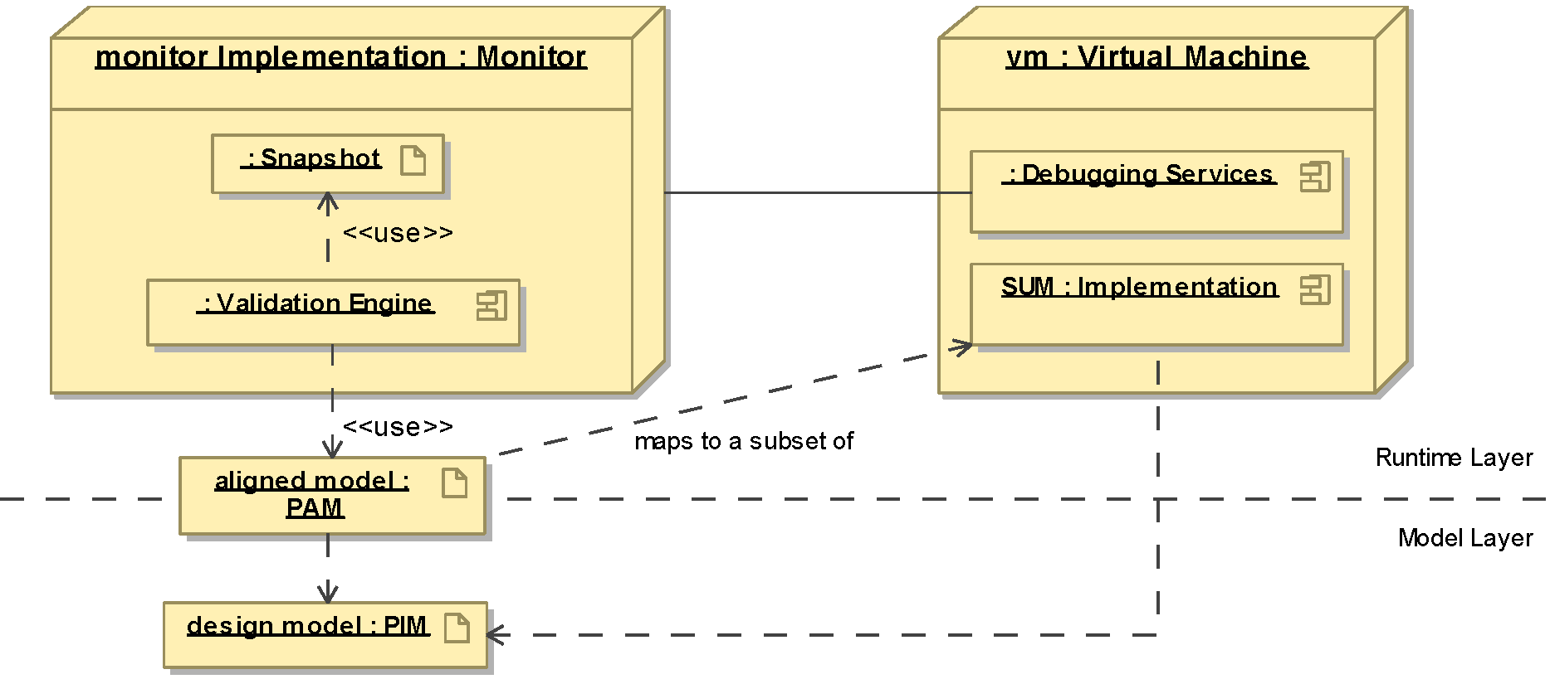
Runtime Monitoring Overview

Slide 10
Platform aligned model
Model between the runtime layer (byte code) and the modelling layer (PIM, PSM)
As abstract as possible:
  No technical classes, e. g., persistence
  Central aspects (core business logic)
  Associations when useful
Specific enough to be able to monitor:
  Identification of classes, attributes, operations,...

Slide 11
Platform aligned model in USE
Example: Existing open source game
Validation of central aspects (game rules)
  “A unit can build a colony if it has moves left”
  “After a colony has been built, the unit has no more moves left”
The PAM has been manually aligned to the PSM

Slide 12
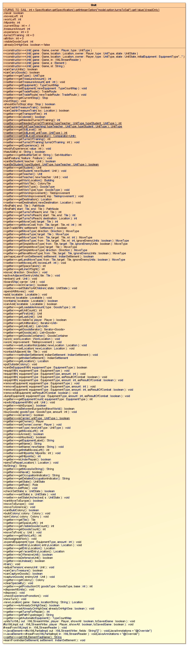
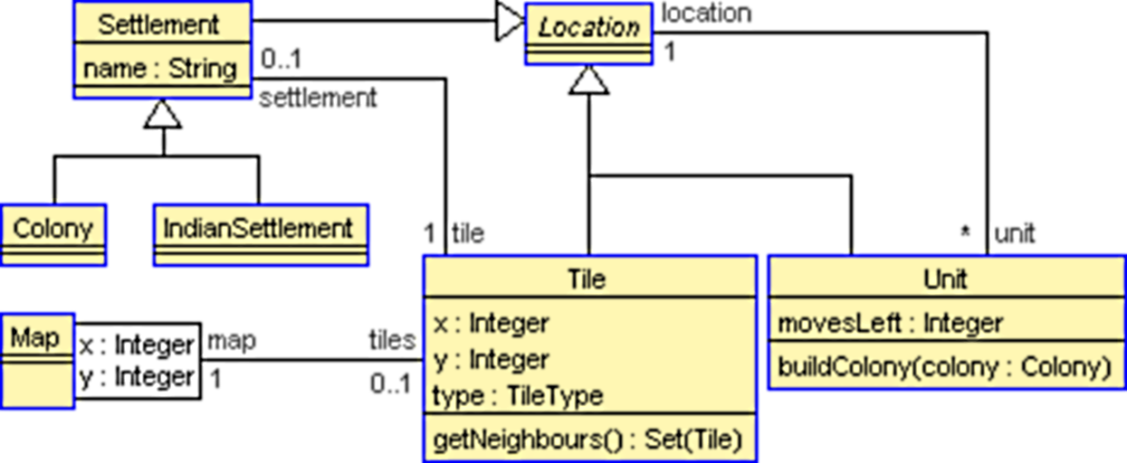
Platform aligned model in USE
package net.sf.freecol.common.model;
public class Unit extends FreeColGameObject
implements Locatable, Location, … {
…
private int movesLeft;
…
public void buildColony(Colony colony){
if (!canBuildColony()) {
throw new IllegalStateException(…);
}
…
}
}
@Monitor(package=
"net.sf.freecol.common.model")
class Unit < Location
attributes
movesLeft : Integer
operations
buildColony(colony:Colony)
pre movesLeft: self.movesLeft > 0
post noMovesLeft: self.movesLeft = 0
end

Slide 13
Snapshot
Instance of a PAM that conforms to the current program state:
  Objects are mapped to instances
  Field values are mapped to corresponding attribute values or links
Can be taken at any time by suspending the running system and examining its state
  In Java: ReferenceType.instances()

Slide 14
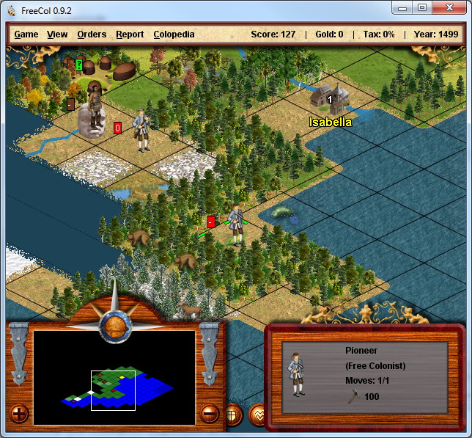
Example program state

Slide 15
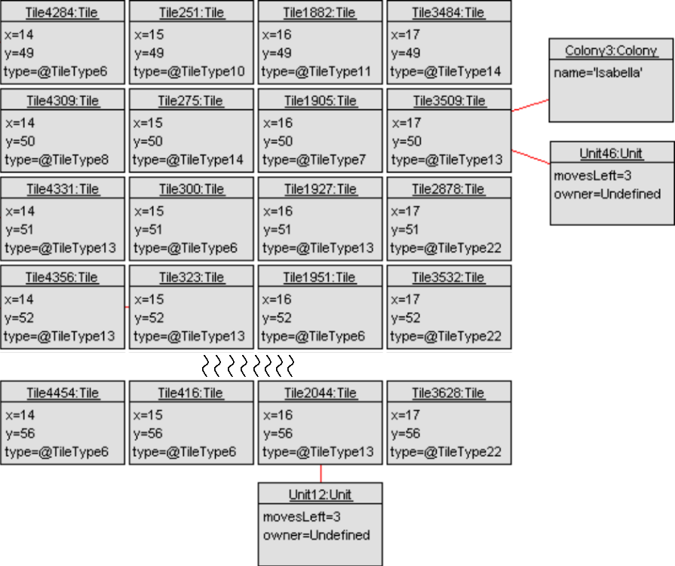
Example snapshot
3???

Slide 16
Dynamic monitoring
Monitor execution of the system
Synchronize snapshot with program state
  Breakpoints at important locations:
    Class initialization
    Constructor, Operation start / end
    Field modifications
Validate constraints at Operations start /end
Optional: Trace execution for visualization

Slide 17
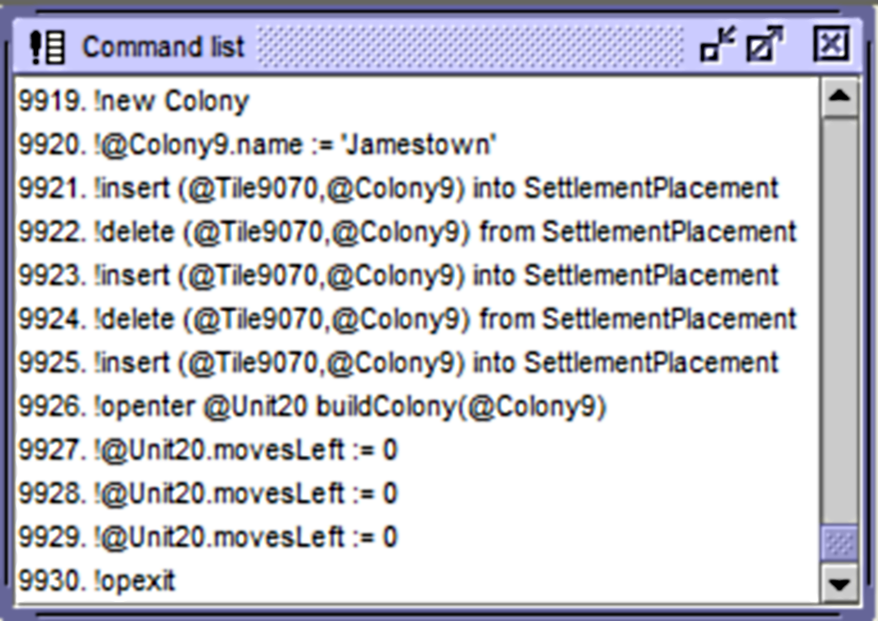
Dynamic monitoring sample
Only buildColony() is monitored
But all atomic operations
  Create
  Insert
  Delete
  Set

Slide 18
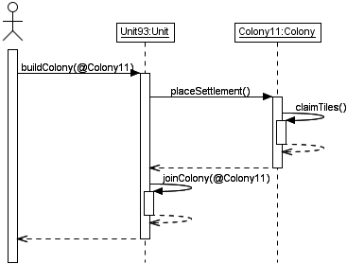
Dynamic monitoring sample
A more detailed PAM (to see what’s happening )

Slide 19
Conclusion
Complete external approach
However, knowledge about interfaces and parts of the structure is required
Start of monitoring at any time (initial snapshot)
  Abstract analysis of program state
  OCL as query language, can be combined with visual techniques
Automatic synchronization of snapshot and program state

Slide 20
Conclusion
Runtime validation of dynamic constraints
  monitor can pause execution on failure
  “abstract debugging”
Approach makes use of powerful VM features
Can be used to generate sample call sequences for documentation purposes

Slide 21
Future work
Monitor as a JVM agent
Many-to-many relationships
When to validate invariants?
(Semi-)automatic detection of constraints
Generation / retrieval of the PAM

Slide 22
Thank‘s for your attention!
Questions?

